Slide 1
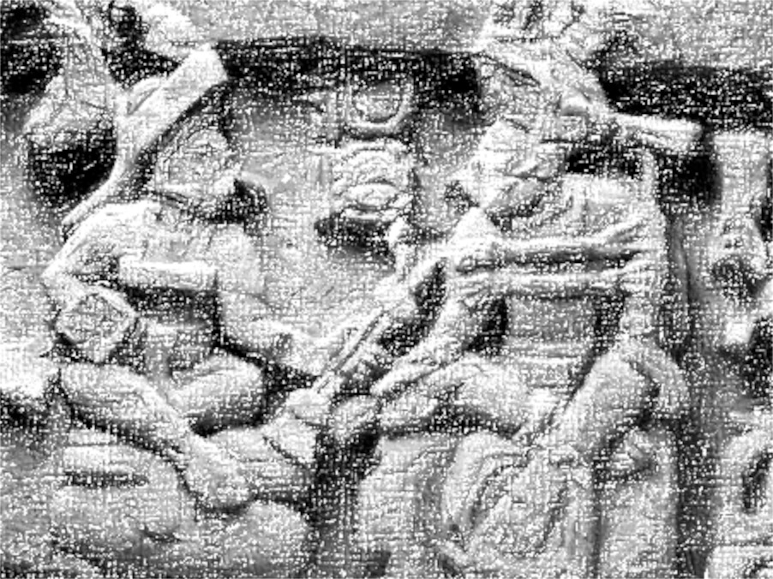
The Spanish Conquest of Yucatán
Lachlan Gray
Snehan Gorain

Slide 2
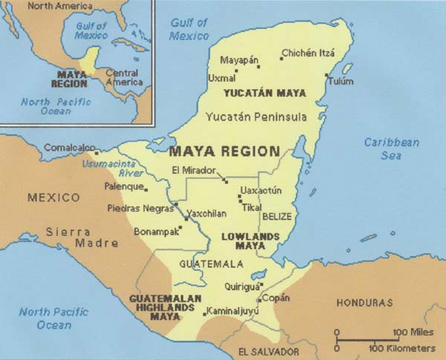

Slide 3
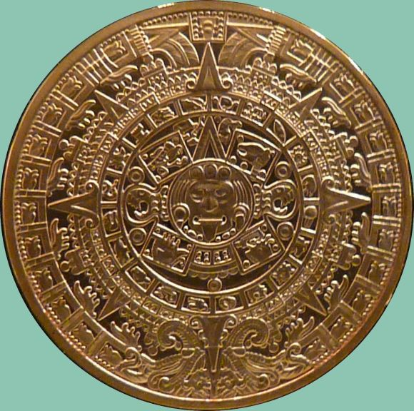
Mayans were converted into Christianity by force
Francisco de Montejo is ordered to conquer Yucatán
Spanish used the Mayans as slaves
Enslavement of Mayans began in 1540
Mayan culture began to decline

Slide 4
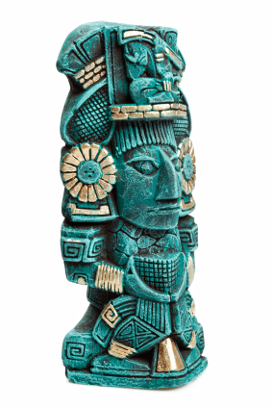
The Mayan population decreased
Mayans were killed and their artifacts burned.
Mayans attacked the Spanish and continued to right their texts in secret
Smallpox killed many Mayans
Mayan culture today is rarely practiced

Slide 5
Mass murder and intimidation
Over 2,200 Mayans were killed
The Spanish used broadswords, rapiers, crossbows, matchlocks, and 3.7 metre spears.
The Spanish arrived in boats
No intervention

Slide 6
The Spanish suffered from disease, attacks and drowning
It took three attempts to conquer most of Yucatán
Mayans havent been given much recognition
Several statues exist in memory of the Mayans
Mayans and their culture declined

Slide 7
